Slide 1
Accounting Principles, 7th Edition
Weygandt • Kieso • Kimmel
Chapter 10
Plant Assets, Natural Resources, and Intangible Assets
Prepared by Naomi Karolinski
Monroe Community College
and
Marianne Bradford
Bryant College
John Wiley & Sons, Inc. © 2005

Slide 2
CHAPTER 10 PLANT ASSETS, NATURAL RESOURCES, AND INTANGIBLE ASSETS
After studying this chapter, you should be able to:
1 Describe how the cost principle applies to plant assets.
2 Explain the concept of depreciation.
3 Compute periodic depreciation using different methods.
4 Describe the procedure for revising periodic depreciation.
5 Distinguish between revenue and capital expenditures, and explain the entries for these expenditures.

Slide 3
PLANT ASSETS, NATURAL RESOURCES, AND INTANGIBLE ASSETS
After studying this chapter, you should be able to:
6 Explain how to account for the disposal of a plant asset.
7 Compute periodic depletion of natural resources.
8 Explain the basic issues related to accounting for intangible assets.
9 Indicate how plant assets, natural resources, and intangible assets are reported and analyzed.

Slide 4
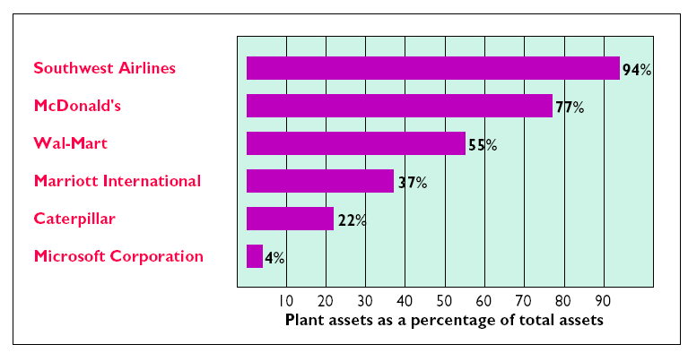
PLANT ASSETS
Plant assets
  tangible resources used in the operations of a business
  not intended for sale to customers
Plant assets are subdivided into four classes:
1 Land
2 Land improvements
3 Buildings
4 Equipment

Slide 5
DETERMINING THE COST OF PLANT ASSETS
STUDY OBJECTIVE 1
Plant assets are recorded at cost in accordance with the cost principle.
Cost
  consists of all expenditures necessary to acquire the asset and make it ready for its intended use
  includes purchase price, freight costs, and installation costs
Expenditures that are not necessary
  recorded as expenses, losses, or other assets

Slide 6

LAND
The cost of Land includes:
1 cash purchase price
2 closing costs such as title and
attorney’s fees
3 real estate brokers’ commissions
4 accrued property taxes and other liens on the
land assumed by the purchaser.
All necessary costs incurred to make land ready
for its intended use are debited to the Land
account.

Slide 7

COMPUTATION OF COST OF LAND
Sometimes purchased land has a building on it that must be removed before construction of a new building. In this case, all demolition and removal costs, less any proceeds from salvaged materials are debited to the Land account.

Slide 8
LAND IMPROVEMENTS
The cost of land improvements includes:
all expenditures needed to make the improvements ready for their intended use such as:
1 parking lots
2 fencing
3 lighting

Slide 9

BUILDINGS
The cost
  includes all necessary expenditures relating to the purchase or construction of a building:
  costs include the purchase price, closing costs, and broker’s commission
Costs to make the building ready for its intended use include
  expenditures for remodeling and replacing or
  repairing the roof, floors, wiring, and plumbing
If a new building is constructed, costs include
  contract price plus payments for architects’
  fees, building permits, interest payments during
  construction, and excavation costs

Slide 10




EQUIPMENT
Cost of equipment
  consists of the cash purchase price and certain related costs
  costs include sales taxes, freight charges, and insurance paid by the purchaser during transit
  includes all expenditures required in assembling, installing, and testing the unit
Recurring costs such as licenses and insurance are expensed as incurred.

Slide 11

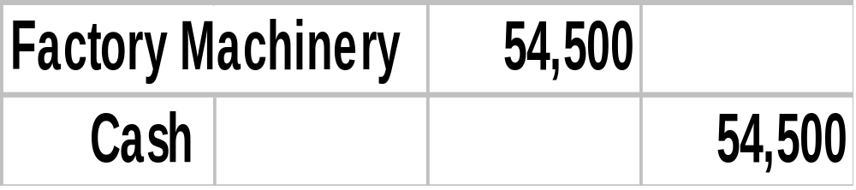
ENTRY TO RECORD PURCHASE OF MACHINERY
The summary entry to record the cost of the factory machinery and related expenditures is as follows:

Slide 12

COMPUTATION OF COST OF DELIVERY TRUCK
The cost of equipment consists of the cash purchase price, sales taxes, freight charges, and insurance during transit paid by the purchaser. It also includes expenditures required in assembling, installing, and testing the unit. However, motor vehicle licenses and accident insurance on company cars and trucks are expensed as incurred, since they represent annual recurring events that do not benefit future periods.

Slide 13
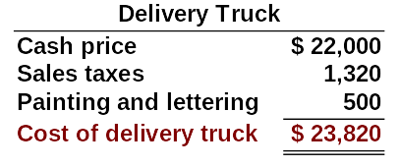
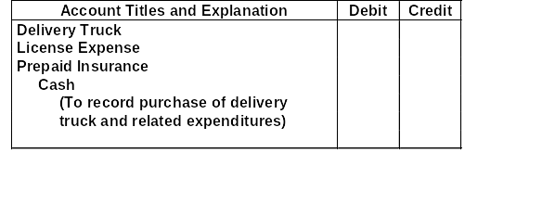
ENTRY TO RECORD PURCHASE OF TRUCK
The entry to record the cost of the delivery truck and related expenditures is as follows:
23,820
80
1,600
25,500

Slide 14
DEPRECIATION
STUDY OBJECTIVE 2
Depreciation
  allocation of the cost of a plant asset to expense over its useful (service) life in a rational and systematic manner.
Cost allocation
  provides for the proper matching of expenses with revenues in accordance with the matching principle.
Usefulness may decline because of wear and tear or obsolescence.
Depreciation does not result in an accumulation of cash for the replacement of the asset.
Land
  is the only plant asset that is not depreciated.

Slide 15
FACTORS IN COMPUTING DEPRECIATION
THREE FACTORS THAT AFFECT THE COMPUTATION OF DEPRECIATION ARE:
1 Cost:
all expenditures necessary to acquire the asset and make it
ready for intended use
2 Useful life:
estimate of the expected life based on need for repair,
service life, and vulnerability to obsolescence
3 Salvage value:
estimate of the asset’s value at the end of its useful life
Notes:
Fix cost slide in.

Slide 16
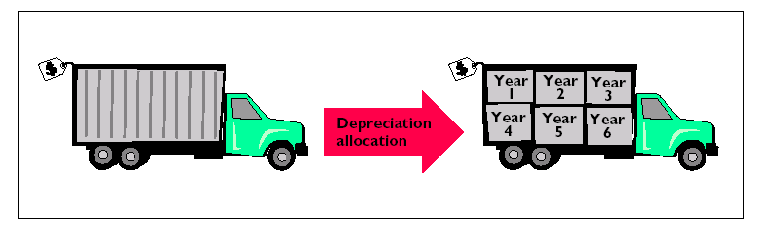
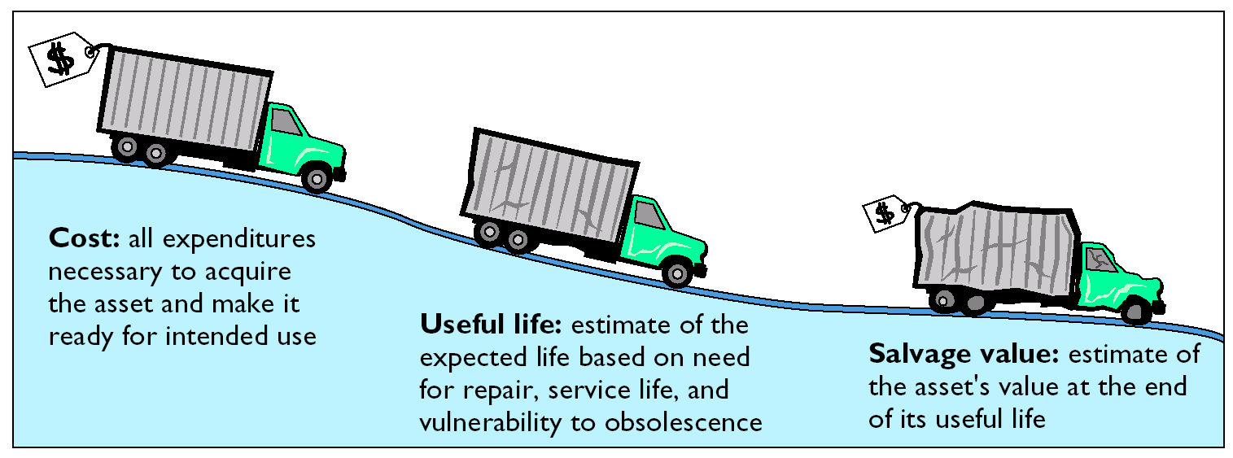
DEPRECIATION

Slide 17
Depreciation is a process of:
Review
valuation.
cost allocation.
cash accumulation.
appraisal.

Slide 18
Depreciation is a process of:
Review
valuation.
cost allocation.
cash accumulation.
appraisal.

Slide 19
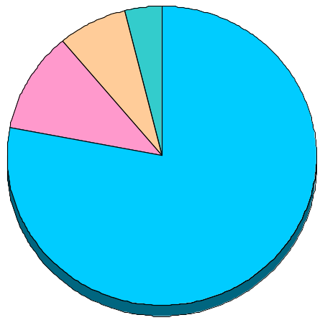

USE OF DEPRECIATION METHODS IN 600 LARGE U.S. COMPANIES
STUDY OBJECTIVE 3
Three methods of recognizing depreciation are: 1 Straight-line,
2 Units of activity, and 3 Declining-balance. Each method is acceptable under generally accepted accounting principles. Management selects the method that is appropriate in the circumstances. Once a method is chosen, it should be applied consistently.
4% Declining balance
5% Units-of-activity
9% Other
82% Straight-line

Slide 20
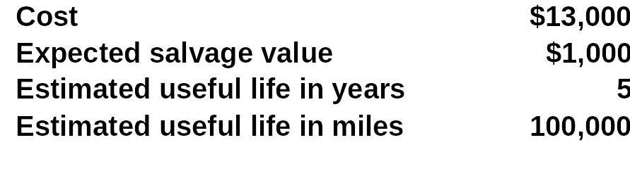
DELIVERY TRUCK DATA
Compare the three depreciation methods, using the following data for a small delivery truck purchased by Barb’s Florists on January 1, 2005.

Slide 21
STRAIGHT-LINE
Straight-line method
  Depreciation is the same for each year of the asset’s useful life.
  It is measured solely by the passage of time.
It is necessary to determine depreciable cost.
Depreciable cost
  total amount subject to depreciation and is computed as follows:
Cost of asset - salvage value

Slide 22
FORMULA FOR STRAIGHT-LINE METHOD
The formula for computing annual depreciation expense is:
Depreciable Cost / Useful Life (in years) = Depreciation Expense
Salvage
Value
Depreciable
Cost
Cost
$13,000 - $1,000 = $12,000
Depreciable
Cost
Useful
Life (in Years)
Annual Depreciation Expense
$12,000 ÷ 5 = $2,400

Slide 23
UNITS-OF-ACTIVITY
Useful life = total units of production or total expected use expressed in hours, miles, etc.
Depreciable Cost ÷ Total Units of Activity = Depreciation Cost per Unit
Depreciation Cost per Unit X Units of Activity During the Year = Annual Depreciation Expense
  It is often difficult to make a reasonable estimate of total activity.
When productivity varies from one period to another, this method results in the best matching of expenses with revenues.

Slide 24
FORMULA FOR UNITS-OF-ACTIVITY METHOD
To use the units-of-activity method, 1) the total units of activity for the entire useful life are estimated, 2) the amount is divided into depreciable cost to determine the depreciation cost per unit, and 3) the depreciation cost per unit is then applied to the units of activity during the year to determine the annual depreciation.
Depreciable Cost
Total Units of
Activity
Depreciable
Cost per Unit
$12,000 ÷ 100,000 miles = $0.12
Depreciable
Cost per Unit
Units of
Activity during the Year
Annual Depreciation Expense
$0.12 x 15,000 miles = $1,800

Slide 25
DECLINING-BALANCE
Decreasing annual depreciation expense over the asset’s useful life
Periodic depreciation is based on a *declining book value
  (cost - accumulated depreciation)
To compute annual depreciation expense
  Multiply the book value at the beginning of the year by the declining-balance depreciation rate
Depreciation rate remains constant from year to year
  book value declines each year

Slide 26
DECLINING-BALANCE
Book value for the first year is the cost of the asset.
  Balance in accumulated depreciation at the beginning of the asset’s useful life is zero
In subsequent years, book value is the difference between cost and accumulated depreciation at the beginning of the year.
Formula for computing depreciation expense:
Book Value at Beginning of Year x Declining Balance Rate = Annual Depreciation Expense
Method compatible with the matching principle
  the higher depreciation in early years is matched with the higher benefits received in these years.

Slide 27
FORMULA FOR DECLINING-BALANCE METHOD
Unlike the other depreciation methods, salvage value is ignored in determining the amount to which the declining balance rate is applied.
A common application of the declining-balance method is the double-declining-balance method, in which the declining-balance rate is double the straight-line rate.
If Barb’s Florists uses the double-declining-balance method, the depreciation is 40% (2 X the straight-line rate of 20%).
Depreciable
Cost per Unit
Units of
Activity during the Year
Annual Depreciation Expense
=
$13,000 x 40% = $5,200

Slide 28
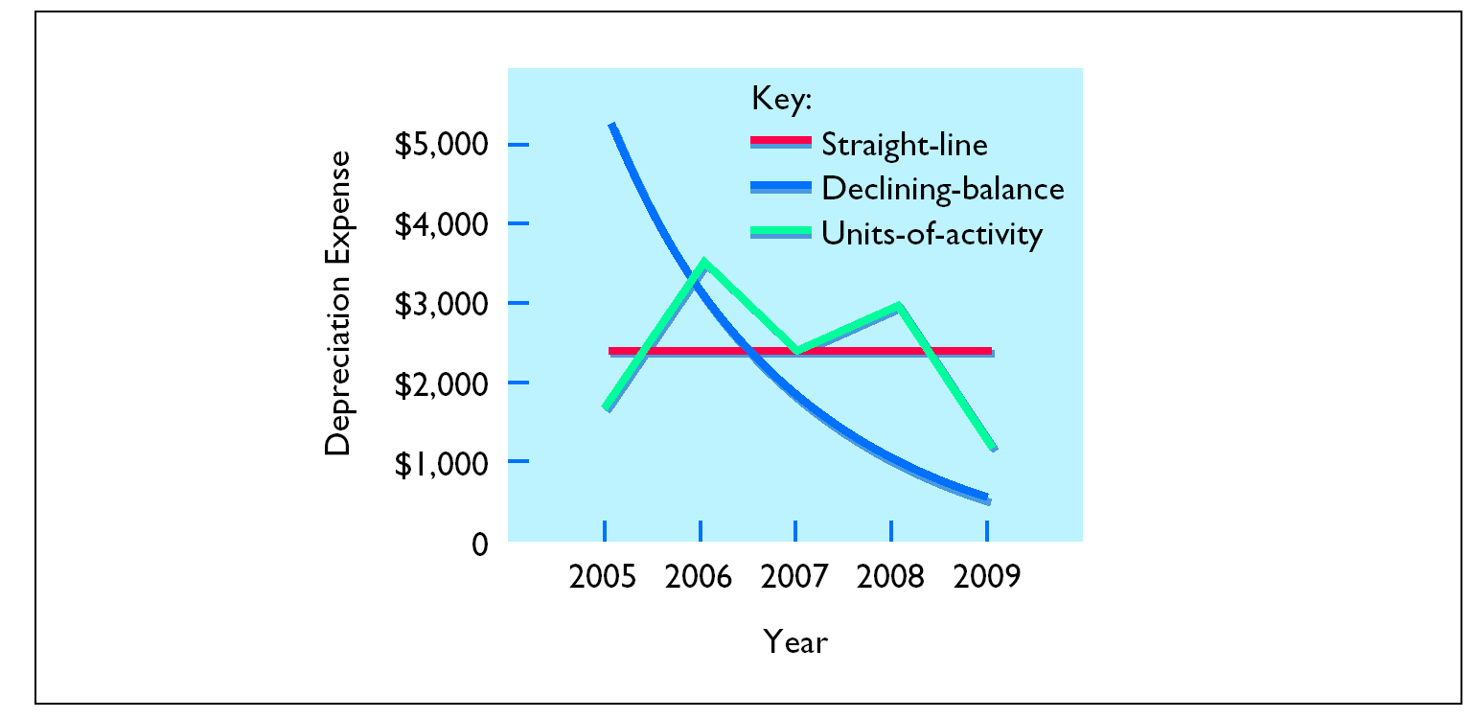
PATTERNS OF DEPRECIATION

Slide 29
REVISING PERIODIC DEPRECIATION
STUDY OBJECTIVE 4
Changes should be made
  Excessive wear and tear or obsolescence indicate that annual depreciation estimates are inadequate.
When a change is made
  No correction of previously recorded depreciation expense
  Depreciation expense for current and future years is revised
To determine the new annual depreciation expense
  The depreciable cost at the time of the revision is divided by the
  remaining useful life.

Slide 30
REVISED DEPRECIATION COMPUTATION
Barb’s Florists decides on January 1, 2008, to extend the useful life of the truck one year because of its excellent condition. The company has used the straight-line method to depreciate the asset to date, and book value is $5,800 ($13,000 - $7,200). The new annual depreciation is $1,600, calculated as follows:
Book value, 1/1/08
$5,800
Less: Salvage value
1,000
Depreciable cost
$4,800
Remaining useful life
3 years
(2008-2010)
Revised annual depreciation ($4,800 ÷ 3)
$1,600

Slide 31

EXPENDITURES DURING USEFUL LIFE
STUDY OBJECTIVE 5
Ordinary repairs
  expenditures to maintain the operating
  efficiency and productive life of the unit
  such repairs are debited to Repairs Expense as
  incurred and are often referred to as revenue
  expenditures.

Slide 32
EXPENDITURES DURING USEFUL LIFE
Capital expenditures
Additions and improvements
  increase the operating efficiency, productive capacity, or useful life of a plant asset
1 Usually material in amount and occur
infrequently.
  2 Increase the company’s investment in
  productive facilities.
  Debit the plant asset affected.

Slide 33
PLANT ASSET DISPOSALS
STUDY OBJECTIVE 6
Retirement
  Plant asset is scrapped or discarded.
  Eliminate the book value of the plant asset at the date of sale by debiting Accumulated Depreciation and crediting the asset account for its cost.
  Debit Cash to record the cash proceeds from the sale.
  Compute gain or loss.
If the cash proceeds > the book value
  recognize a gain by crediting Gain on Disposal for the difference.
If the cash proceeds are < the book value
  recognize a loss by debiting Loss on Disposal for the
  difference.

Slide 34
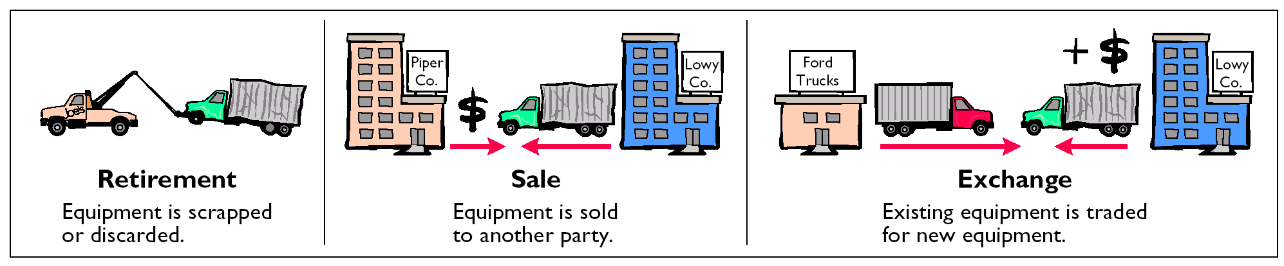
PLANT ASSET DISPOSALS

Slide 35
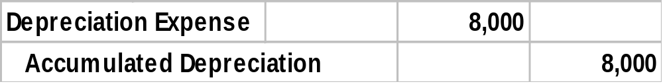
GAIN ON DISPOSAL
On July 1, 2005, Wright Company sells office furniture for $16,000 cash. Original cost was $60,000 and as of January 1, 2005, had accumulated depreciation of $41,000. Depreciation for the first 6 months of 2005 is $8,000. The entry to record depreciation expense and update accumulated depreciation to July 1 is as follows:

Slide 36
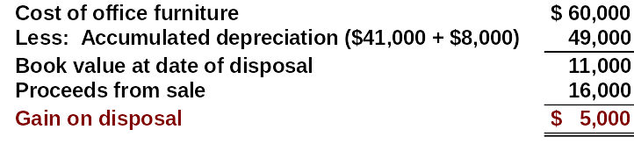
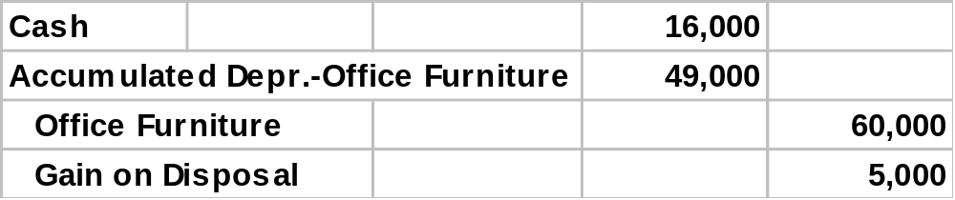
GAIN ON DISPOSAL
After the accumulated depreciation is updated, a gain on disposal of $5,000 is computed:
The entry to record the sale and the gain on disposal is as follows:

Slide 37
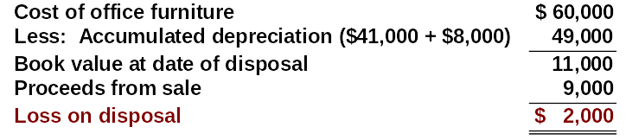
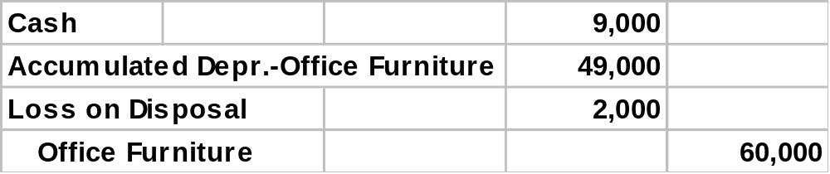
LOSS ON DISPOSAL
Instead of the selling the office furniture for $16,000, Wright sells it for $9,000. In this case, a loss of $2,000 is computed:
The entry to record the sale and the loss on disposal is as follows:

Slide 38



NATURAL RESOURCES
STUDY OBJECTIVE 7
Natural resources
  consists of standing timber and underground deposits of oil, gas, and minerals
These long-lived productive assets have two distinguishing characteristics:
1 They are physically extracted in operations.
2 They are replaceable only by an act of nature.

Slide 39
DEPLETION
DEPLETION
Allocation of the cost of natural resources to expense in a rational and systematic manner over the resource’s useful life.
Units-of-activity method is generally used to compute depletion.
  depletion generally is a function of the units extracted during the year

Slide 40
FORMULA TO COMPUTE DEPLETION EXPENSE
Total Cost minus Salvage Value
Total Estimated Units
Depletion
Cost per Unit
Depletion
Cost per Unit
Number of
Units Extracted and Sold
Annual Depletion
Expense
Helpful hint: This computation for depletion is similar to the computation for depreciation using the units-of-activity method of depreciation.

Slide 41
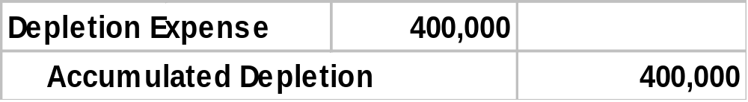
RECORDING DEPLETION
The Lane Coal Company invests $5 million in a mine estimated to have 10 million tons of coal and no salvage value. In the first year, 800,000 tons of coal are extracted and sold. Using the formulas, the calculations are as follows:
$5,000,000 ÷ 10,000,000 = $.50 depletion cost per ton
$.50 X 800,000 = $400,000 depletion expense
The entry to record depletion expense for the first year of operations is as follows:

Slide 42
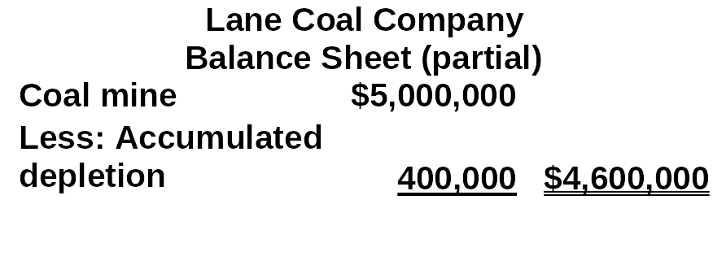
STATEMENT PRESENTATION OF
ACCUMULATED DEPLETION
Accumulated Depletion is a contra asset account similar to accumulated depreciation. It is deducted from the cost of the natural resource in the balance sheet as follows:

Slide 43



INTANGIBLE ASSETS
Study Objective 8
Intangible assets
  Rights, privileges, and competitive advantages that result from the ownership of long lived assets that do not possess physical substance
  May arise from government grants, acquisition of another business, and private monopolistic arrangements

Slide 44
ACCOUNTING FOR INTANGIBLE ASSETS
In general, accounting for intangible assets parallels the accounting for plant assets.
Intangible assets are:
1 recorded at cost
2 written off over useful life in a rational and systematic manner
3 at disposal, book value is eliminated and gain or loss, if any, is recorded

Slide 45
ACCOUNTING FOR INTANGIBLE ASSETS
STUDY OBJECTIVE 8
Key differences between accounting for intangible assets and accounting for plant assets include:
  The systematic write-off of an intangible asset is referred to as amortization
To record amortization
  Debit Amortization Expense and credit the specific intangible asset
  Intangible assets typically amortized on a straight-line basis

Slide 46
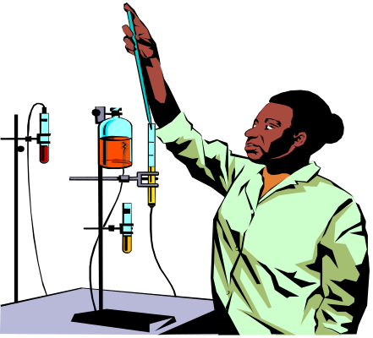
PATENTS
A patent
  exclusive right issued by the Patent Office
  manufacture, sell, or otherwise control an invention for a period of 20 years from the date of grant
Cost of a patent
  initial cost is the cash or cash equivalent price paid to acquire the patent
  legal costs – amount an owner incurs in successfully defending a patent are added to the Patent account and amortized over the remaining useful life of the patent
  should be amortized over its 20-year legal life or its useful life, whichever is shorter.

Slide 47
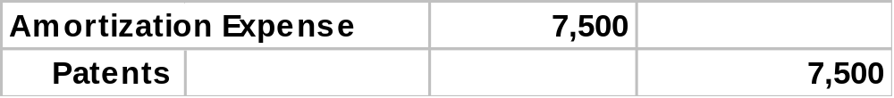
RECORDING PATENTS
National Labs purchases a patent at a cost of $60,000. If the useful life of the patent is 8 years, the annual amortization expense is $7,500 ($60,000 ÷ 8).
Amortization Expense is classified as an operating expense in the income statement. The entry to record the annual patent amortization is:

Slide 48



COPYRIGHTS
Copyrights
  grants from the federal government
  gives the owner the exclusive right to reproduce and sell an artistic or published work
Copyrights extend for the life of the creator plus 70 years.
The cost of a copyright is the cost of acquiring and defending it.

Slide 49

TRADEMARKS AND TRADE NAMES
A trademark or trade name
  word, phrase, jingle or symbol identifying a particular enterprise or product
Trademark or trade name purchased
  the cost is purchase price
Trademark developed by a company
  the cost includes attorney’s fees, registration
  fees, design costs and successful legal defense
  fees

Slide 50
FRANCHISES AND LICENSES
Franchise
  contractual arrangement under which the franchisor grants the franchisee the right to sell certain products, render specific services, or use certain trademarks or trade names, usually restricted to a designated geographical area
Another type of franchise, commonly referred to as a license or permit
  entered into between a governmental body and a business enterprise and permits the enterprise to use public property in performing its services.

Slide 51

GOODWILL
Goodwill
  value of all favorable attributes that relate to a business enterprise
  attributes may include exceptional management, desirable location, good customer relations and skilled employees
  cannot be sold individually in the marketplace; it can be identified only with the business as a whole

Slide 52

GOODWILL
Goodwill
  recorded only when a transaction involves the purchase of an entire business
  excess of cost over the fair market value of the net assets (assets less liabilities) acquired
  not amortized
  reported under Intangible Assets

Slide 53


RESEARCH AND DEVELOPMENT COSTS
Research and development costs
  pertain to expenditures incurred to develop
  new products and processes
These costs are not intangible costs
  recorded as an expense when incurred

Slide 54
FINANCIAL STATEMENT PRESENTATION
STUDY OBJECTIVE 9
Plant assets and natural resources
  Under “property, plant, and equipment” in the balance sheet
  Major classes of assets, such as land, buildings, and equipment, and accumulated depreciation by major classes or in total should be disclosed
  Depreciation and amortization methods that were used should be described. Finally, the amount of depreciation and amortization expense for the period should be disclosed
Intangibles are shown separately under intangible assets

Slide 55
LANDS’ END’S PRESENTATION OF PROPERTY, PLANT, AND EQUIPMENT, AND INTANGIBLES
The financial statement presentation of property, plant, and equipment by Lands’ End in its 2005 balance sheet is quite brief, as shown below:
Balance Sheet - Partial
December 31, 2005 (in thousands)
Jan. 28, 2005
Jan. 29, 2004
Property, plant and equipment, at costs
Land and buildings
102,776
102,018
Fixtures and equipment
175,910
154,663
Leasehold improvements
4,453
5,475
Total property, plant and equipment
283,139
262,156
Less: accumulated depr. and amort.
117,317
101,570
Property, plant and equipment, net
165,822
160,586
Intangibles, net
966
1,030
The notes to Lands’ End financial statements present greater details, namely, that “intangibles” contains goodwill and trademarks…
Notes:
DO YOU Have Text Art for Illustration 10-23

Slide 56
PRESENTATION OF PROPERTY, PLANT, AND EQUIPMENT AND INTANGIBLE ASSETS
A more comprehensive presentation of property, plant, and equipment
is excerpted from the balance sheet of Owens-Illinois and shown below.
OWENS-ILLINOIS, INC.
Balance Sheet - Partial
(In millions of dollars)
Property, plant, and equipment
Timberlands, at cost, less accumulated depletion
$ 95.4
Buildings and equipment, at cost
$ 2,207.1
Less: Accumulated depreciation
1,229.0
978.1
Total property, plant, and equipment
$ 1,073.5
Intangibles
Patents
410.0
Total
$ 1,483.5

Slide 57
EXCHANGES OF PLANT ASSETS
Exchanges
  can be for similar or dissimilar assets
  For similar assets, the new asset performs the same function as the old asset
Necessary to determine two things:
1) the cost of the asset acquired
2) the gain or loss on the asset given up

Slide 58
LOSS TREATMENT
Losses on exchange of similar assets
  recognized immediately
Cost of the new asset received
  equal to the fair market value of the old asset exchanged plus any cash or other consideration given up
Losses result when the book value is greater than the fair market value of the asset given up.

Slide 59
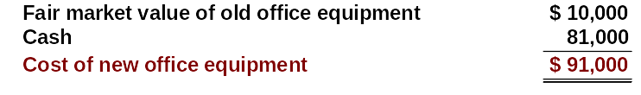
COMPUTATION OF COST OF NEW OFFICE EQUIPMENT
Roland Company exchanges old office equipment for new similar office equipment. The book value of the old office equipment is $26,000 ($70,000 cost less $44,000 accumulated depreciation), AND its fair market value is $10,000, and $81,000 of cash is paid. The cost of the new office equipment, $91,000, is calculated as follows:

Slide 60

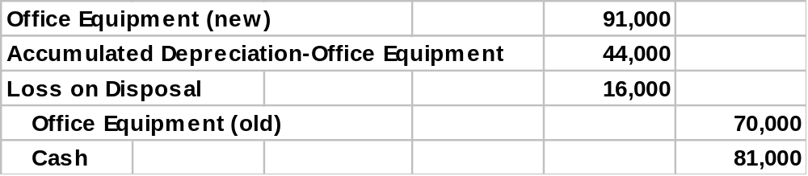
COMPUTATION OF LOSS ON DISPOSAL
Through this exchange, a loss on disposal of $16,000 is incurred. A loss results when the book value is greater than the fair market value of the asset given up. The calculation is as follows:
In recording the exchange at a loss three steps are required: 1) eliminate the book value of the asset given up, 2) record the cost of the asset acquired, and 3) recognize the loss on disposal.

Slide 61
GAIN TREATMENT
Gains of similar assets
  not recognized immediately, but, are deferred
  by reducing the cost basis of the new asset
Cost of the new asset
  fair market value of the old asset exchanged
  plus any cash or other consideration given up
Gains result when the fair market value is greater than the book value of the asset given up

Slide 62

COST OF NEW EQUIPMENT (BEFORE DEFERRAL OF GAIN)
Mark’s Express Delivery exchanges old delivery equipment plus $3,000 cash for new delivery equipment. The book value of the old delivery equipment is $12,000 ($40,000 cost less $28,000 accumulated depreciation), its fair market value is $19,000. The cost of the new delivery equipment, $22,000, is calculated as follows:

Slide 63

COMPUTATION OF GAIN ON DISPOSAL
For Mark’s Express Delivery, there is a gain of $7,000, calculated as follows, on the disposal:

Slide 64

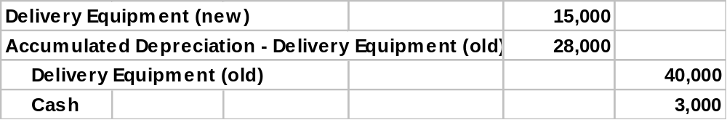
COST OF NEW DELIVERY EQUIPMENT (AFTER DEFERRAL OF GAIN)
The $7,000 gain on disposal is then offset against the $22,000 cost of the new delivery equipment. The result is a $15,000 cost of the new delivery equipment, after deferral of the gain.
The entry to record the exchange is as follows:

Slide 65
ACCOUNTING RULES FOR PLANT EXCHANGES
Type of Event Recognition
Loss Recognize immediately by debiting Loss on Disposal
Gain Defer and reduce cost of new asset

Slide 66
In exchanges of similar assets:
Review
neither gains nor losses are recognized immediately.
b. gains, but not losses, are recognized immediately.
c. losses, but not gains, are recognized immediately.
d. both gains and losses are recognized immediately.

Slide 67
In exchanges of similar assets:
Review
neither gains nor losses are recognized immediately.
gains, but not losses, are recognized immediately.
losses, but not gains, are recognized immediately.
both gains and losses are recognized immediately.

Slide 68

COPYRIGHT
Copyright © 2005 John Wiley & Sons, Inc. All rights reserved. Reproduction or translation of this work beyond that permitted in Section 117 of the 1976 United States Copyright Act without the express written consent of the copyright owner is unlawful. Request for further information should be addressed to the Permissions Department, John Wiley & Sons, Inc. The purchaser may make back-up copies for his/her own use only and not for distribution or resale. The Publisher assumes no responsibility for errors, omissions, or damages, caused by the use of these programs or from the use of the information contained herein.

